Slide 1

Department of Computer Science, CUI Lahore Campus
Formal Methods in Software Engineering
By
Farooq Ahmad

Slide 2
Relations
Relation as Abstract Data Type

Slide 3
Topics
Mathematical definition of relation
Relations in Z
Relation as a Data type
Declaring relation variables

Slide 4
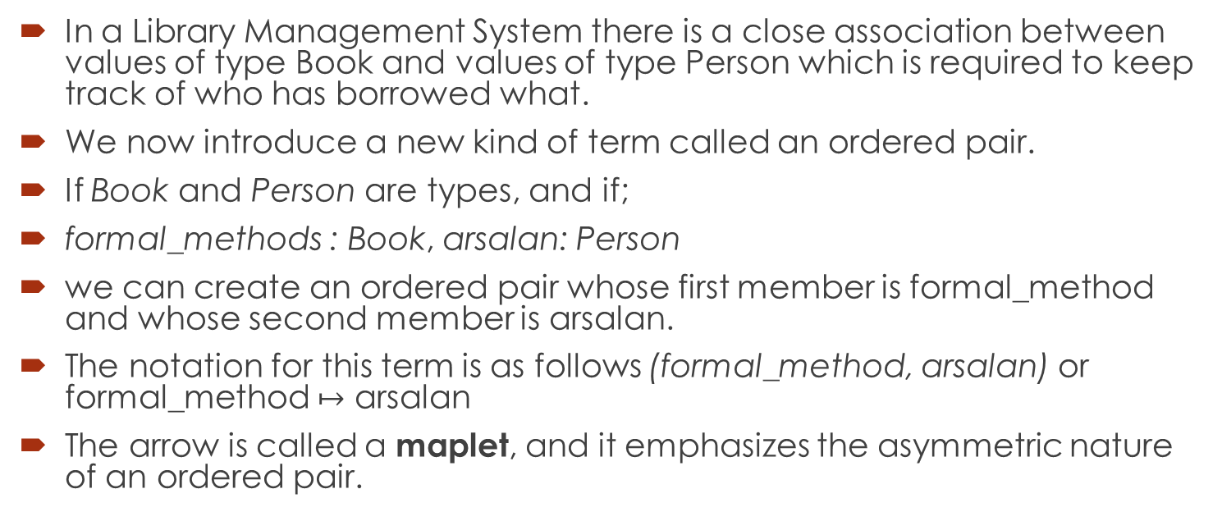
Order pairs
In a Library Management System there is a close association between values of type Book and values of type Person which is required to keep track of who has borrowed what.
We now introduce a new kind of term called an ordered pair.
If Book and Person are types, and if;
formal_methods : Book, arsalan: Person
we can create an ordered pair whose first member is formal_method and whose second member is arsalan.
The notation for this term is as follows (formal_method, arsalan) or formal_method $↦$ arsalan
The arrow is called a maplet, and it emphasizes the asymmetric nature of an ordered pair.

Slide 5
Relation in Z
In a formal specification, it is often necessary to describe relationships between objects e.g.
– this record is stored under that key,
– this input channel is connected to that one
– this book is borrowed by that person
Such associations can be described using simple mathematical objects called relations.
In our mathematical language, a relation is a set of ordered pairs, a subset of a Cartesian product.
If X and Y are sets, then X ↔Y denotes the set of all relations between X and Y

Slide 6
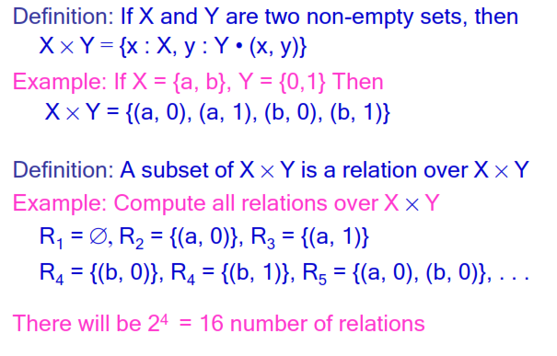
Binary Relation

Slide 7
Formal definition of relation
The formal definition of a relation is {a: A, b:B|P(a,b) • (a, b)}
For example, the set
{a, b:N |a + b=4 • (a, b)}
Relations are normally named. Naming a relation is equivalent to naming the set of pairs which make up the relation. Thus, the relation eqless {x, y: N | x =y ˅ x<4} can be written as either the constructive specification
eqless = {x, y: N | x = y ˅ x < 4}

Slide 8
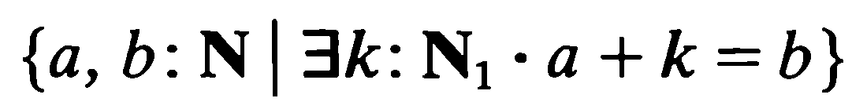
Defining relation using Set comprehension notation.
Less_than relation for set of non-negative integers
Write down it into the axiomatic form

Slide 9
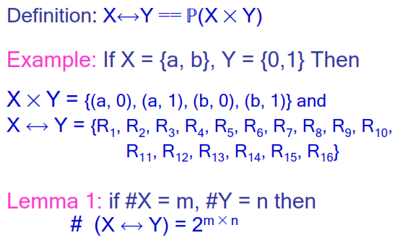
Making Relation as a Type

Slide 10
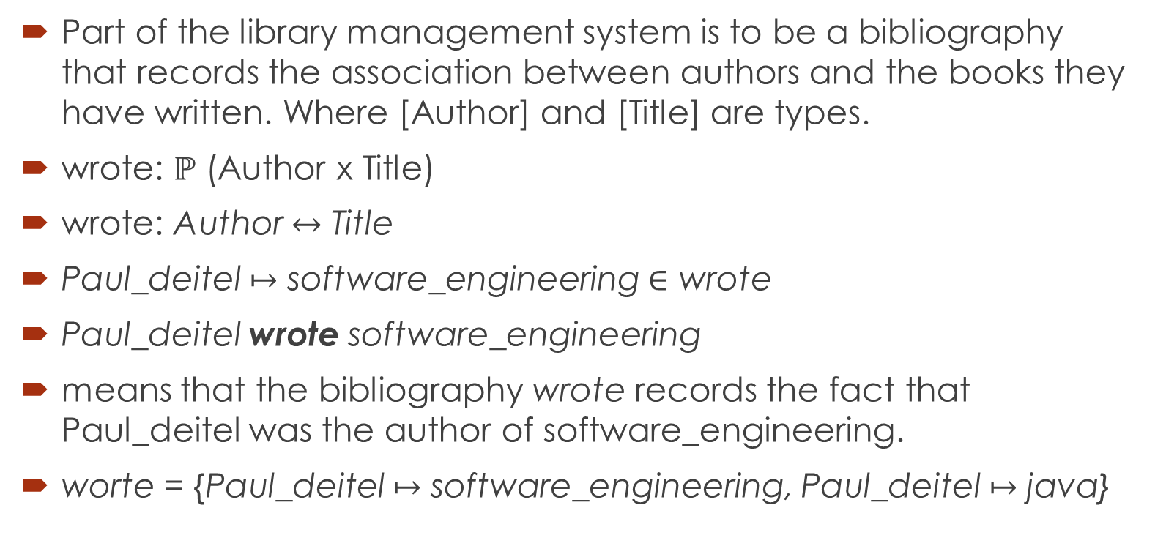
Declaring relation variables
Part of the library management system is to be a bibliography that records the association between authors and the books they have written. Where [Author] and [Title] are types.
wrote: $ℙ$ (Author x Title)
wrote: Author $↔$ Title
Paul_deitel $↦$ software_engineering $∈$ wrote
Paul_deitel wrote software_engineering
means that the bibliography wrote records the fact that Paul_deitel was the author of software_engineering.
worte = {Paul_deitel $↦$ software_engineering, Paul_deitel $↦$ java}

Slide 11
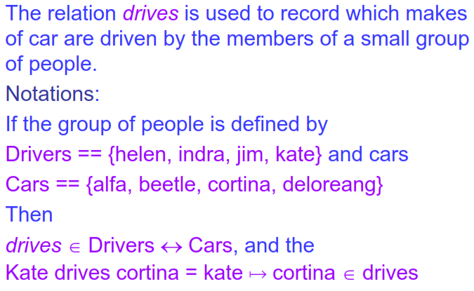
Example

Slide 12
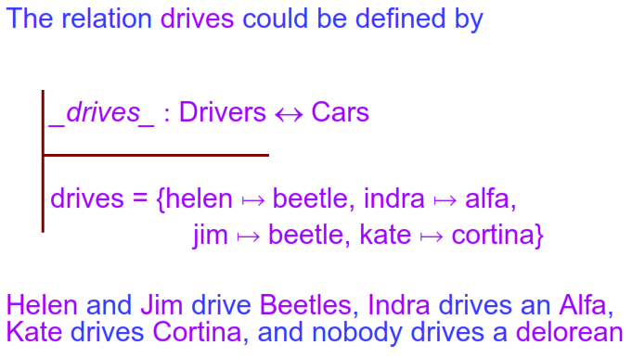
A small relation can be defined by enumeration

Slide 13
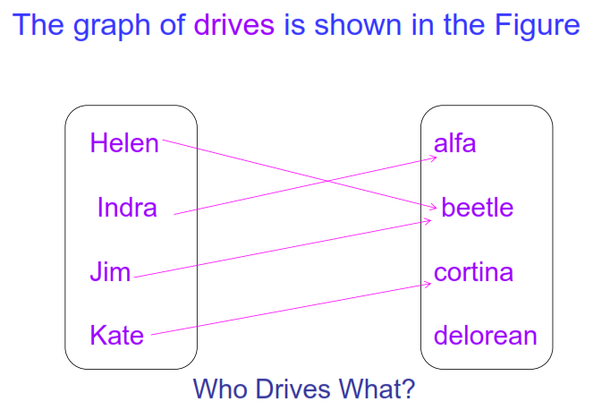
Mapping showing the value of variable drives

Slide 14
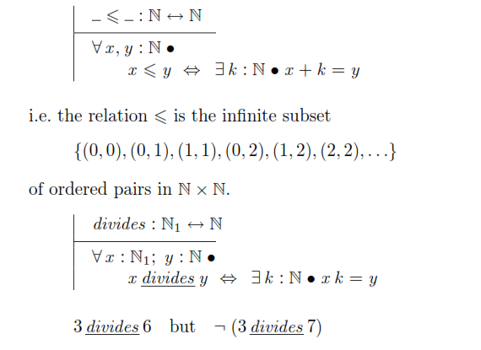
Relation which is not possible to describe by enumeration
27

Slide 15
Splitting the order pairs
The Z functions first and second split an ordered pair into its first and second coordinates.
first (madge, homer) = madge
second (madge, homer) = homer
first and second are known as the projection functions for ordered pairs.

Slide 16
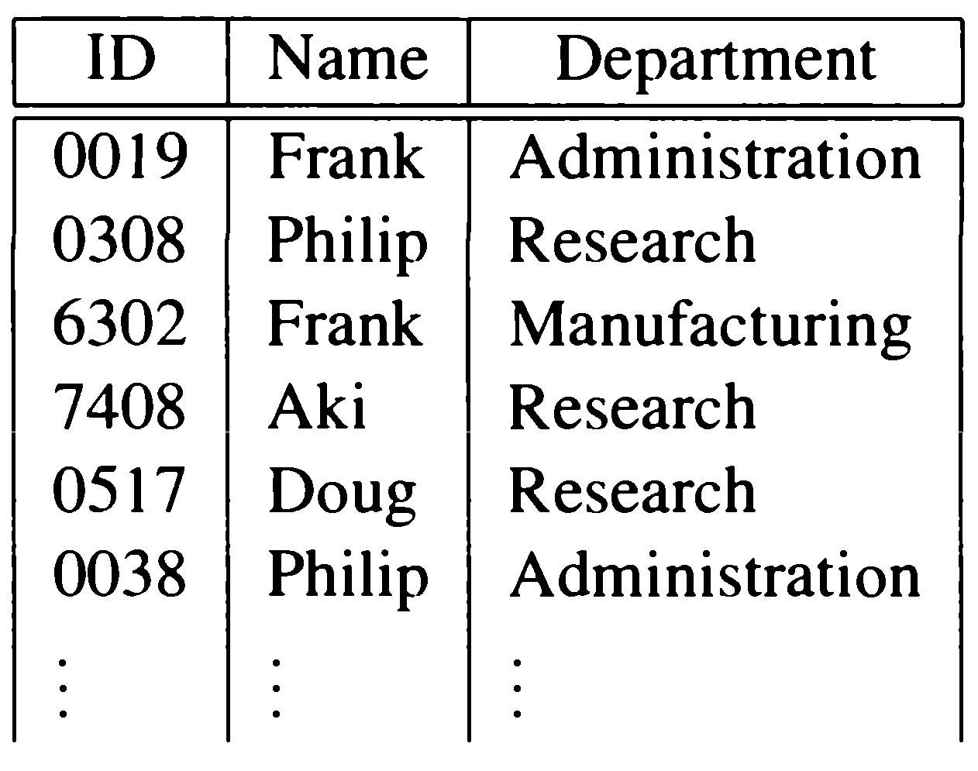
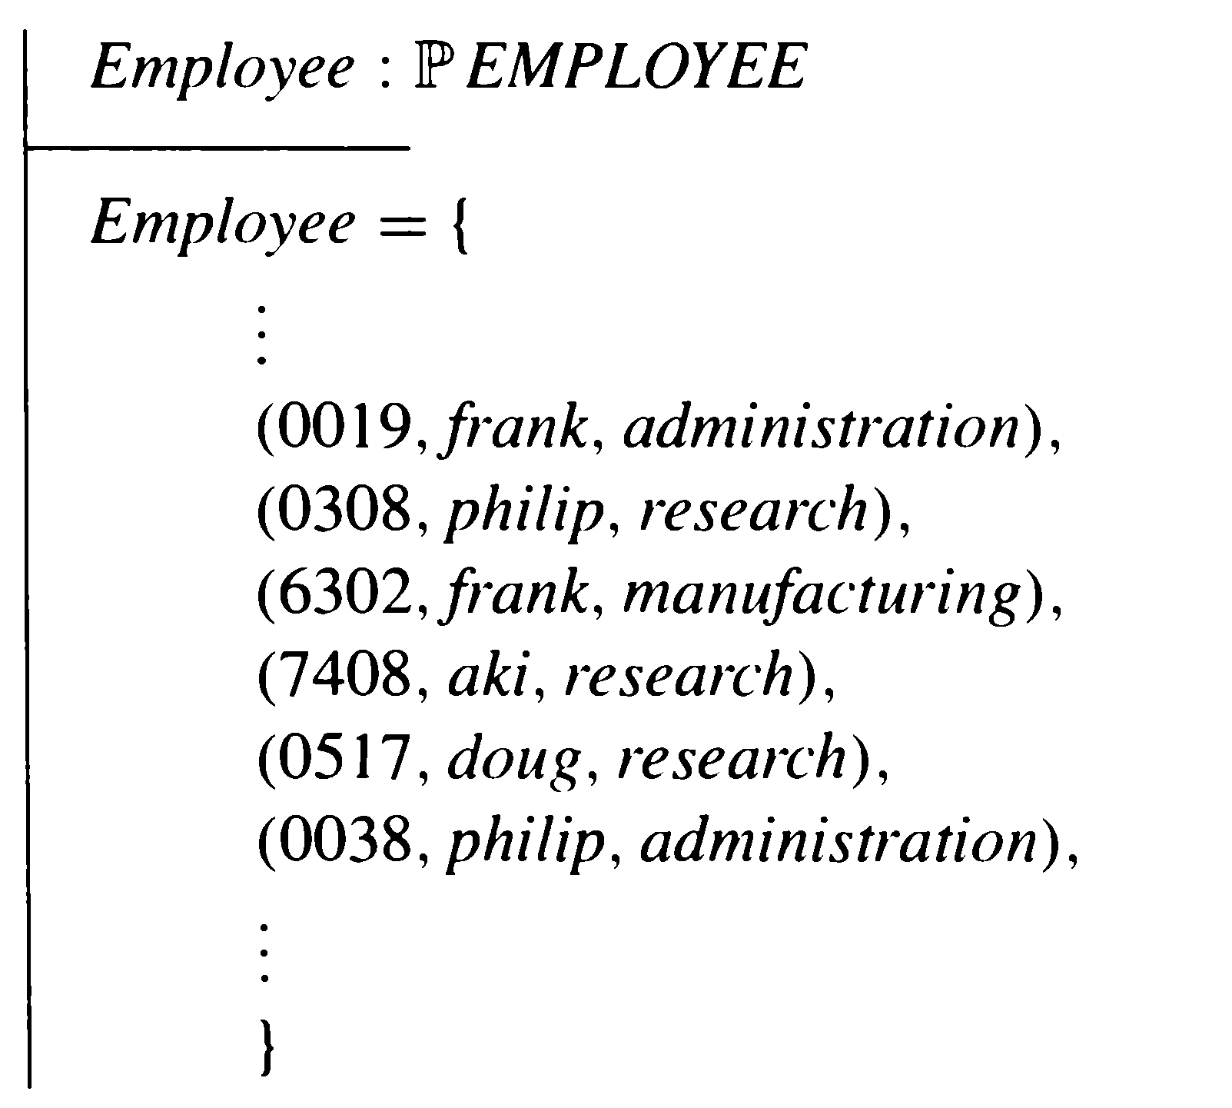
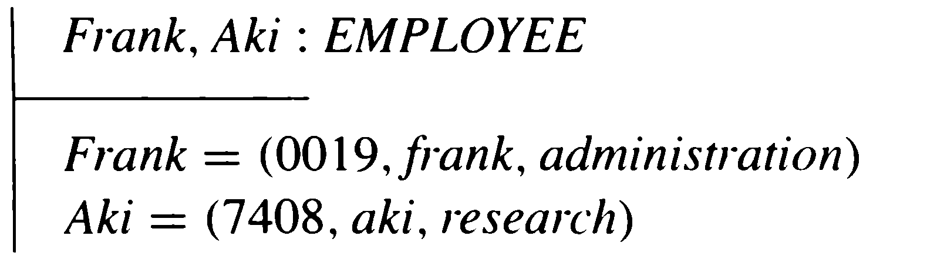
Relations as tables in databases

Slide 17
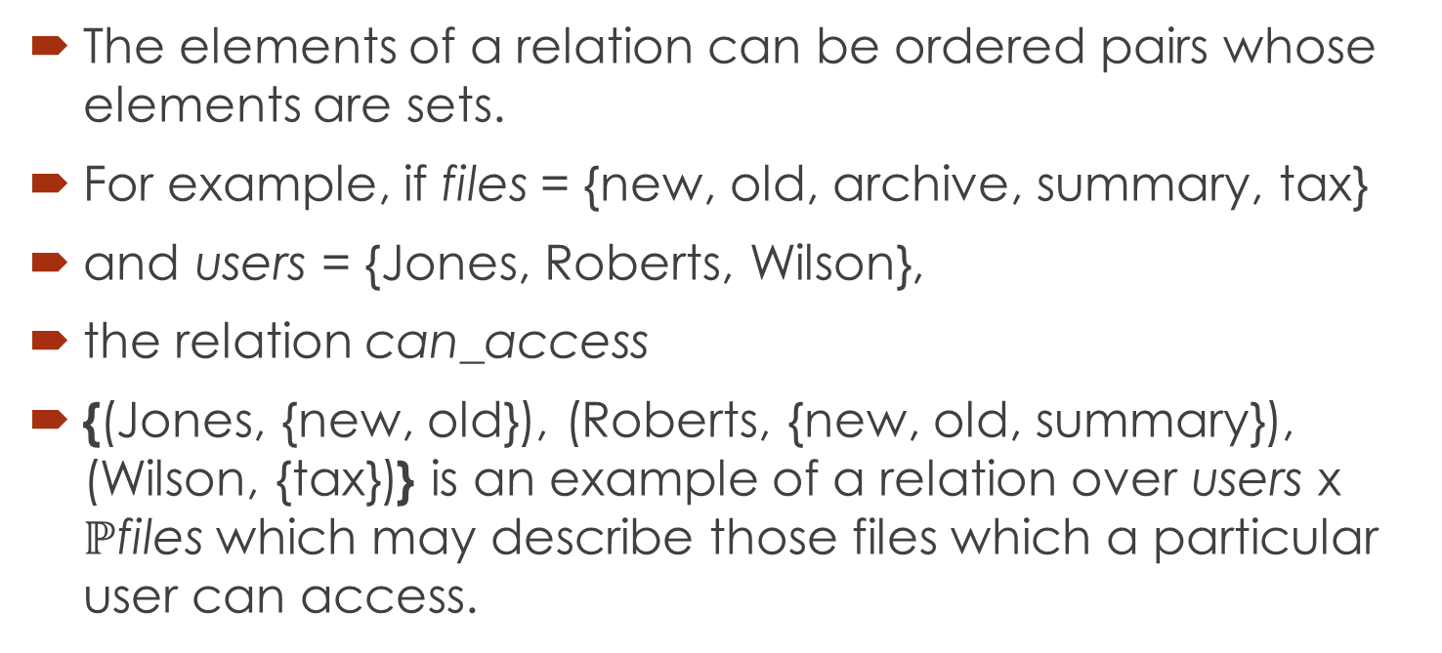
Elements of ordered pairs as sets
The elements of a relation can be ordered pairs whose elements are sets.
For example, if files = {new, old, archive, summary, tax}
and users = {Jones, Roberts, Wilson},
the relation can_access
{(Jones, {new, old}), (Roberts, {new, old, summary}), (Wilson, {tax})} is an example of a relation over users x $ℙ$files which may describe those files which a particular user can access.

Slide 18
Domain and range
A relation may contain a great information;
often, we require only a small part.
To enable us to extract the information that we need, a number of basic functions are included in our mathematical language.
The simplest examples are the
– Domain function
– Range functions

Slide 19
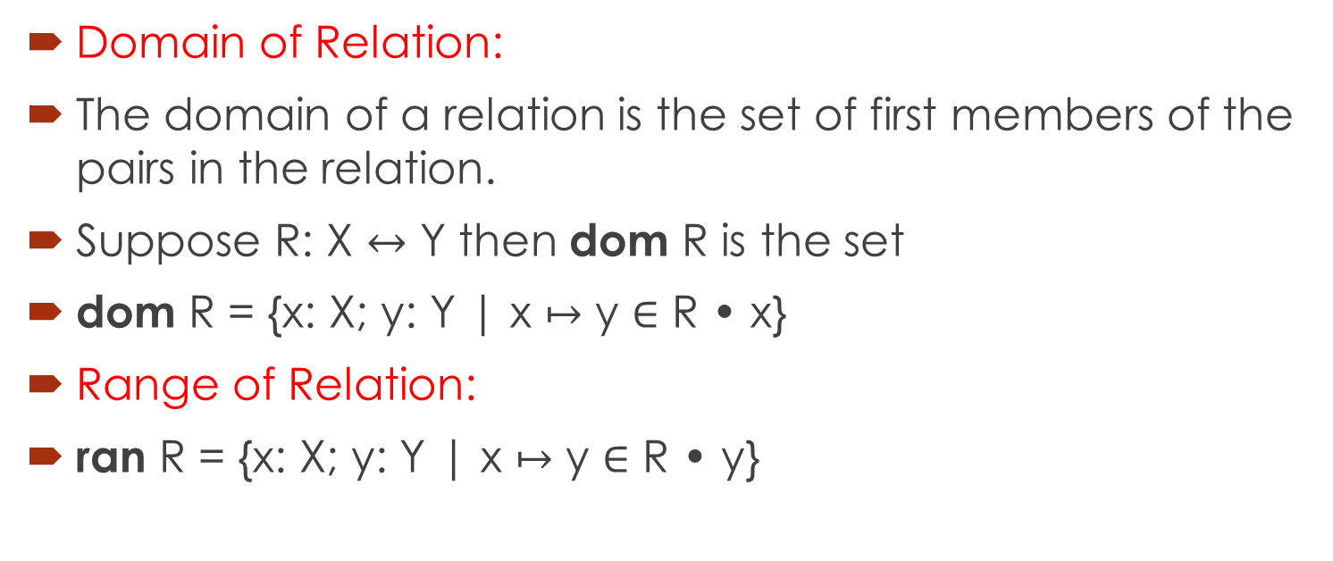
Domain and range
Domain of Relation:
The domain of a relation is the set of first members of the pairs in the relation.
Suppose R: X $↔$ Y then dom R is the set
dom R = {x: X; y: Y | x $↦$ y ∈ R • x}
Range of Relation:
ran R = {x: X; y: Y | x $↦$ y ∈ R • y}

Slide 20
Example of dom and ran
If owns is a relation over Users x Files and its current value
is {(Jones, tax), (Jones, new), (Roberts, summary), (Wilson, archive)},
then dom owns is {Jones, Roberts, Wilson}.
The set dom owns is subset of the set Users
And ran owns is {tax, new, summary, archive}
The set ran owns is the subset of the set Files

Slide 21
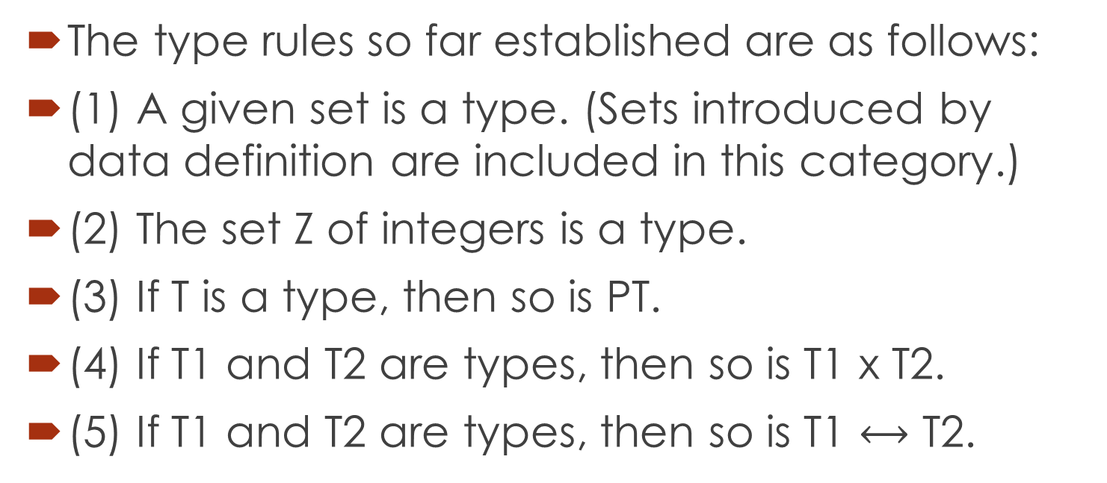
Data Type rules, so far
The type rules so far established are as follows:
(1) A given set is a type. (Sets introduced by data definition are included in this category.)
(2) The set Z of integers is a type.
(3) If T is a type, then so is PT.
(4) If T1 and T2 are types, then so is T1 x T2.
(5) If T1 and T2 are types, then so is T1 $⟷$ T2.

Slide 22
Reference and reading material
Chapter 4: Section 4.1.1 to 4.1.5 of the book “Software Development with Z”.

